Slide 1
Database Systems
Lecture 3-Chapter # 14
DATABASE DESIGN THEORY AND NORMALIZATION
Alina Arshad
alina.arshad@nu.edu.pk

Slide 2
Second Normal Form
Uses the concepts of FDs, primary key
Definitions
Prime attribute: An attribute that is member of the primary key K
Full functional dependency: a FD Y -> Z where removal of any attribute from Y means the FD does not hold any more
Examples:
{SSN, PNUMBER} -> HOURS is a full FD since neither SSN -> HOURS nor PNUMBER -> HOURS hold
{SSN, PNUMBER} -> ENAME is not a full FD (it is called a partial dependency ) since SSN -> ENAME also holds

Slide 3
Second Normal Form
Definition.
In the 2NF, relational must be in 1NF.
In the second normal form, all non-key attributes are fully functional dependent on the primary key
OR there should be no partial dependency
Partial dependency can be identified by the rule:
LHS(proper subset of candidate key/Primary key) && RHS (Non Prime Attribute)

Slide 4

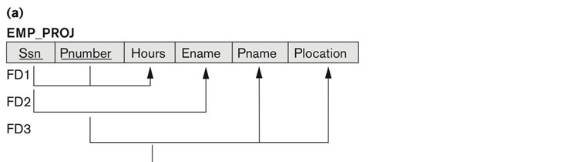
Second Normal Form
Solve this
Figure 14.11
Normalizing into 2NF and 3NF. (a) Normalizing EMP_PROJ into 2NF relations. (b) Normalizing EMP_DEPT into 3NF relations.

Slide 5

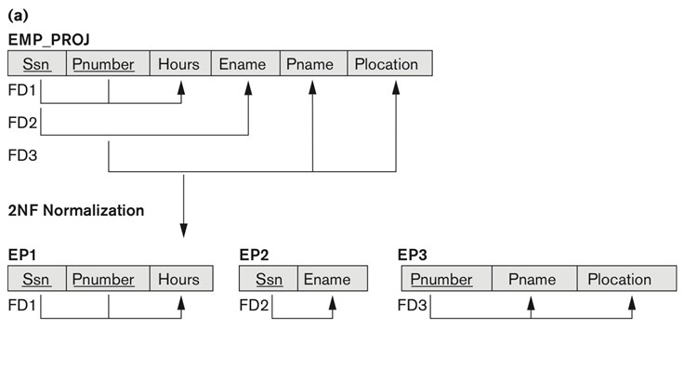
Figure 14.11
Normalizing into 2NF and 3NF. (a) Normalizing EMP_PROJ into 2NF relations. (b) Normalizing EMP_DEPT into 3NF relations.
Second Normal Form

Slide 6
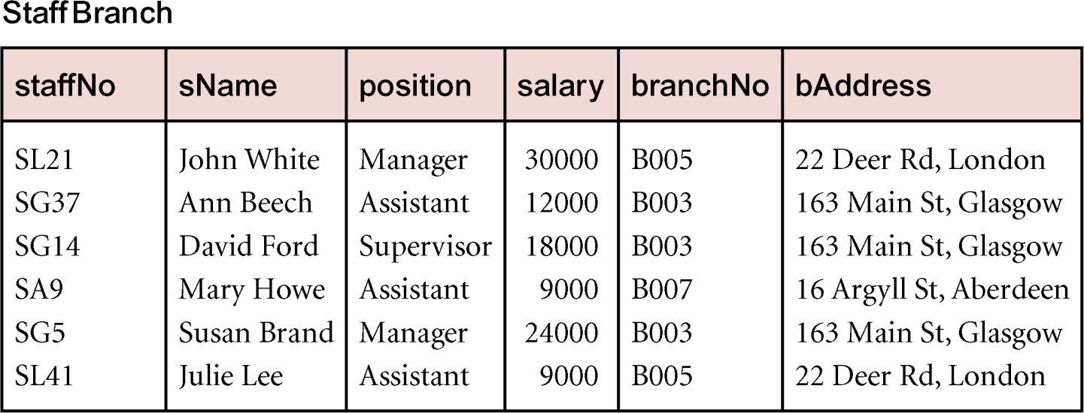
Normalize this table upto 3nf

Slide 7
Example Transitive Dependency
Consider functional dependencies in the Staff-Branch relation staffNo → sName, position, salary, branchNo, bAddress
branchNo → bAddress
Transitive dependency, branchNo → bAddress exists on staffNo via branchNo

Slide 8
Third Normal Form
Definition. a relation schema R is in 3NF if it satisfies 2NF and no nonprime attribute of R is transitively dependent on the primary key.
Definition of Transitive functional dependency:
Transitive functional dependency: a FD X -> Z that can be
derived from two FDs X -> Y and Y -> Z
Examples:
SSN -> DMGRSSN is a transitive FD
Since SSN -> DNUMBER and DNUMBER -> DMGRSSN hold
SSN -> ENAME is non-transitive
Since there is no set of attributes X where SSN -> X and X -> ENAME

Slide 9

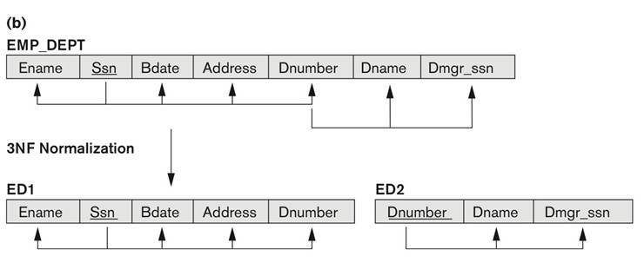
Third Normal Form
General Definition. A relation schema R is in third normal form (3NF) if, whenever a nontrivial functional dependency X → A holds in R, either
X is a super key/Candidate key of R,
OR
A is a prime attribute of R.
Figure 14.11
Normalizing into 2NF and 3NF. (b) Normalizing EMP_DEPT into 3NF relations.

Slide 10
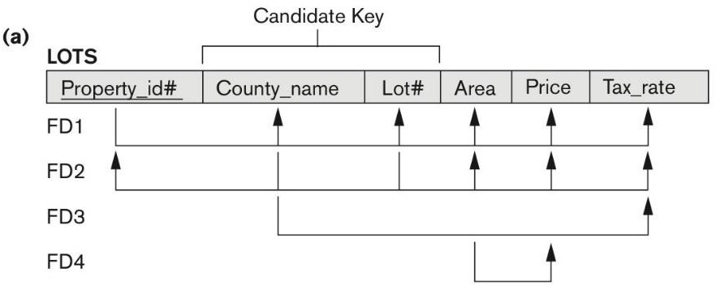
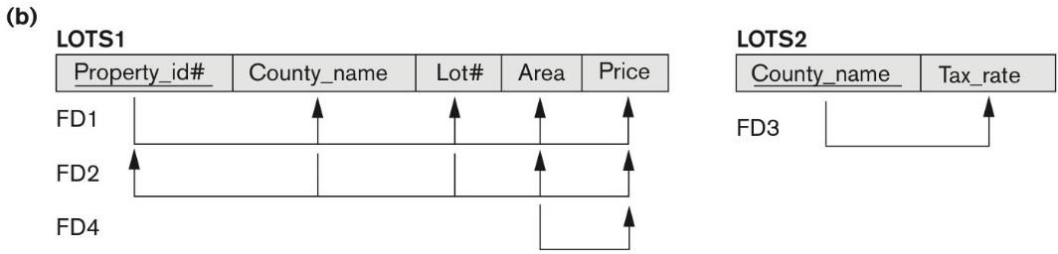
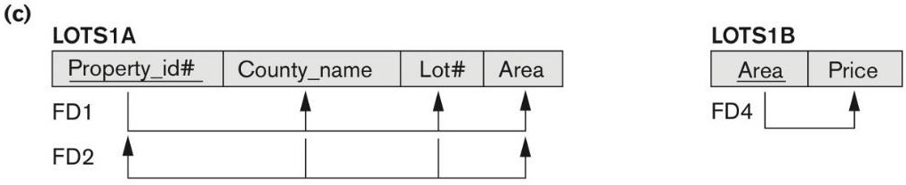
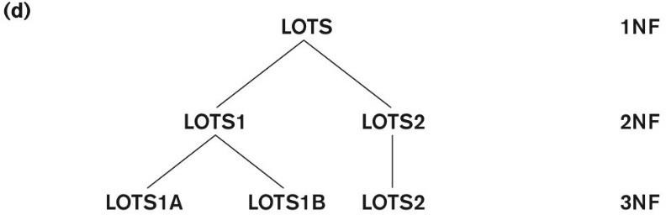
Figure 14.12 Normalization into 2NF and 3NF. (a) The LOTS relation with its functional dependencies FD1 through FD4.
(b) Decomposing into the 2NF relations LOTS1 and LOTS2. (c)
Decomposing LOTS1 into the 3NF relations LOTS1A and LOTS1B.
(d) Progressive normalization of LOTS into a 3NF design.
Tax_rate is partially dependent on the candidate key
Price is transitively dependent on each of the candidate keys via non-prime attribute area

Slide 11
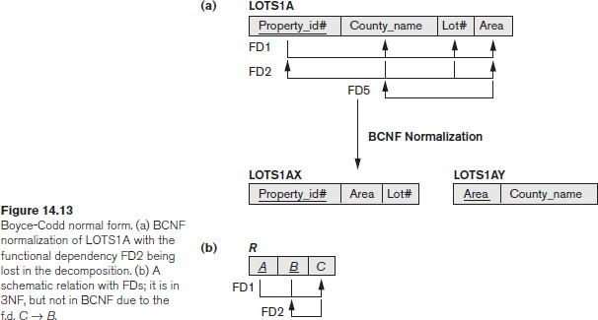
Boyce-Codd Normal Form
Definition. A relation schema R is in BCNF if whenever a nontrivial functional dependency X → A holds in R, then X is a superkey of R.

Slide 12

Decomposition of Relations not in BCNF
FD1: {Student, Course} Instructor
FD2:14 Instructor Course

Slide 13
Decomposition of Relations not in BCNF
FD1: {Student, Course} Instructor
FD2:14 Instructor Course
Normalized Relations:
R1 (Instructor, Course) and R2(Instructor, Student)

Slide 14
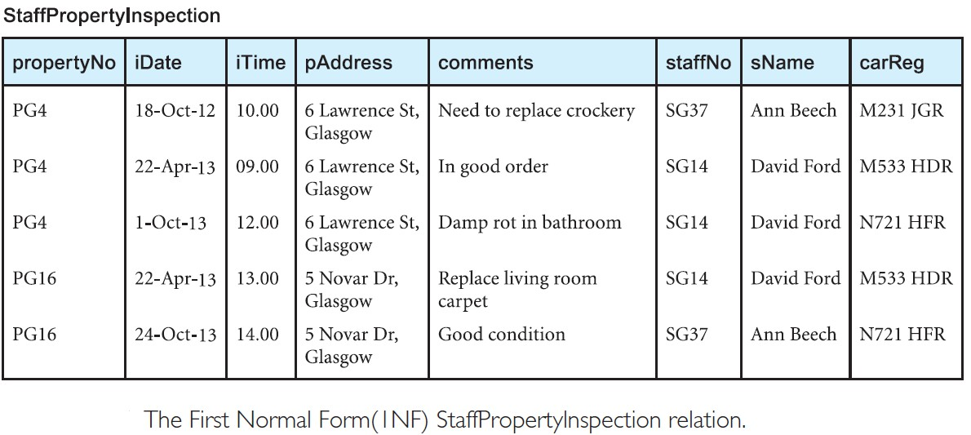

Slide 16
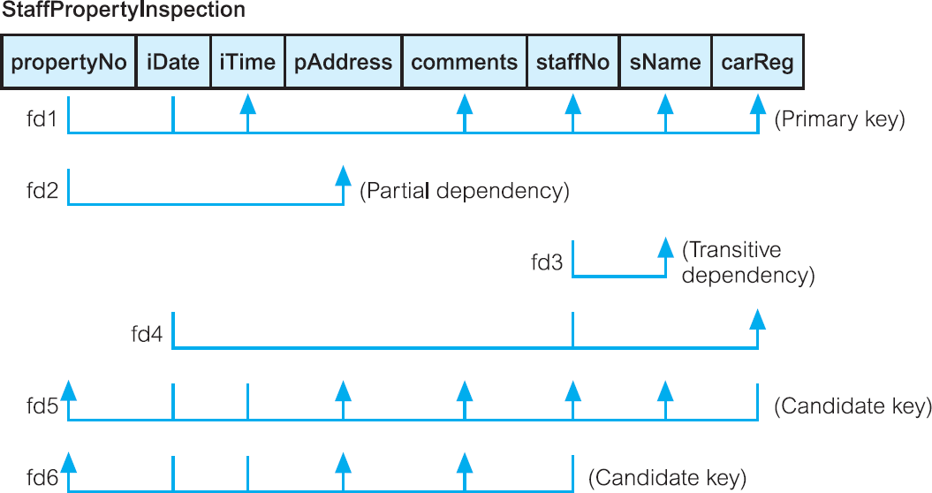
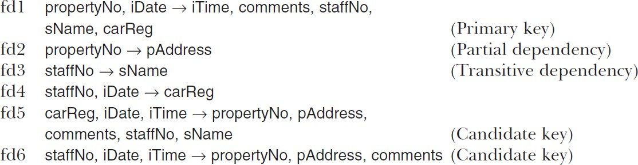

Slide 17
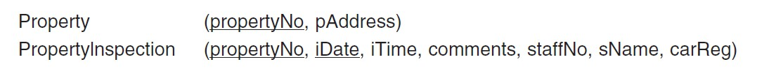
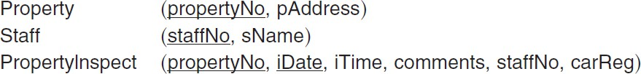
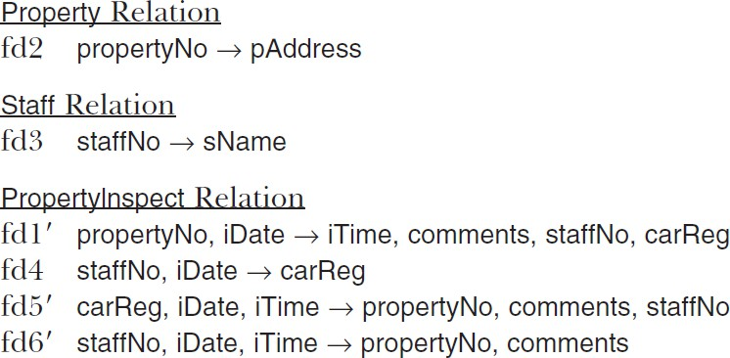
Second Normal Form (2NF)
Third Normal Form (3NF)
Boyce–Codd Normal Form (BCNF)

Slide 18
